Slide 1

Title: Detection and Control of Leaks in Water Supply Networks
Team Details:
Names: DHARSAN R / 211423104129
HARINATH S / 211423104201
Batch Number: K-7 Domain: Machine Learning
Guide Name & Designation Coordinator Name & Designation
Date: 27/10/25 Mr.DHAKSHUNHAAMOORTHIY
Professor

Slide 2


SDGs AND TARGETS 1) Primary Goal No:6 Clean Water and Sanitation
Targets:
6.1 – Achieve universal and equitable access to safe and affordable drinking water for all.
6.3 – Improve water quality by reducing pollution and minimizing leak-related contamination.
6.4 – Substantially increase water-use efficiency and reduce water scarcity.
2) Secondary Goal No:11 Sustainable Cities and Communities
Targets:
11.3 – Enhance inclusive and sustainable urbanization and capacity for participatory planning.
11.5 – Reduce the adverse effects of disasters, including those related to water infrastructure failure.
11.b – Adopt integrated policies and plans for resilience and resource efficiency.

Slide 3

3)Tertiary Goal No:9 – Industry, Innovation and Infrastructure
Targets:
9.1 – Develop quality, reliable, sustainable infrastructure to support economic development.
9.4 – Upgrade infrastructure and make it sustainable through clean and efficient technologies.
9.5 – Enhance scientific research and innovation in smart infrastructure solutions.

Slide 4

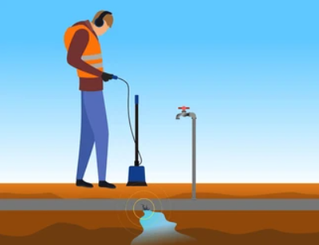
Problem Statement
What is the social problem being addressed?
Water distribution systems often suffer from undetected leaks, leading to significant water loss and wastage. Addressing this issue through effective leak detection techniques is critical to conserving water,
reducing economic losses, and promoting sustainable water
management for society.
Who is affected and how?
1) Local Communities: Face reduced access to clean and safe drinking
water, which can harm public health and sanitation.
2) Water Utilities: Suffer increased operational and maintenance costs
due to wasted water and damaged infrastructure.

Slide 5
Problem Statement
Data / Stats
Water Loss: On average, 20-30% of treated water is lost due to leaks worldwide; in some cities, this can be as
high as 40-50%.
Detection Efficiency: Traditional leak detection methods can detect only about 30-50% of leaks, while
advanced techniques like acoustic sensors and machine learning can improve detection rates to over 80%.
One-Line Problem Summary
Undetected leaks in water distribution systems cause significant water loss, threatening water security,
public health, and economic sustainability.
Mapped SDG Goal(s)
SDG 6: Clean Water and Sanitation
Ensuring availability and sustainable management of water for all by reducing water loss and improving
water quality.
Target 6.4:
“Increase water-use efficiency and ensure sustainable freshwater supply to
reduce water scarcity by 2030.”

Slide 6

Abstract
1) The project addresses water loss in distribution systems due to undetected
leaks.
2) It aims to design and implement an efficient leak detection system.
3) Technologies such as pressure sensors, flow meters and data analysis are
used.
4) The goal is to reduce non-revenue water and improve supply reliability.
5) The project supports SDG 6, particularly Target 6.4 on improving water use
efficiency.
6) Benefits include reduced water waste, low maintenance costs, and sustainable
water management.

Slide 7
Research and Literature Review
1. Rahman et al., “Real-Time Leak Detection in Urban Water Networks Using LSTM and Edge AI”, IEEE Access, 2023
Aspect | Details
Author | Rahman et al.
Summary | Combines LSTM models with edge computing to perform leak detection on embedded IoT devices in real time.
Relevance | Minimizes cloud dependency; supports real-time anomaly detection on-site.
Gaps | Limited by memory and processing power of edge devices.
Impact | Enables smart, autonomous leak detection without continuous network connection.

Slide 8
Research and Literature Review
2. Ahmed et al., “Smart Water Loss Detection with TinyML and ESP32 Sensors”, Sensors and Actuators A: Physical, 2024
Aspect | Details
Author | Ahmed et al.
Summary | Implements TinyML models (lightweight ML) on ESP32 boards for leak detection using vibration and pressure sensors.
Relevance | Makes low-cost, battery-efficient leak detection feasible.
Gaps | Limited to detection (no localization); training data must be carefully optimized.
Impact | Democratizes leak detection for low-budget rural and urban utilities.

Slide 9
Research and Literature Review
3. Rao & Sharma, “Real-Time Leak Forecasting with Transformer Models in Smart Water Networks”, IEEE Transactions on Smart Cities, 2025
Aspect | Details
Author | Rao & Sharma.
Summary | Uses Transformer-based deep learning models to predict potential leak events in advance using multivariate sensor data.
Relevance | Leverages the latest deep learning trends for predictive maintenance.
Gaps | Requires high-quality, synchronized multi-sensor data for training.
Impact | Enables proactive maintenance by forecasting leaks before they occur.

Slide 10
Research and Literature Review
4. Das et al., “Federated Learning for Leak Detection in Distributed Water Supply Systems”, IEEE Internet of Things Journal, 2023
Aspect | Details
Author | Das et al.
Summary | Proposes a privacy-preserving leak detection system using federated learning across different water utilities without sharing raw data.
Relevance | Ideal for collaborative learning across cities/regions with sensitive data.
Gaps | Needs robust synchronization and federated infrastructure.
Impact | Enables collaborative intelligence without compromising data security.

Slide 11
Research and Literature Review
5. Mohammed et al., “CNN-Based Leak Classification from Acoustic Signals in Water Pipes”, Measurement, 2024
Aspect | Details
Authors | Mohammed et al.
Summary | Applies Convolutional Neural Networks to classify leaks from spectrograms of acoustic data gathered via hydrophones.
Relevance | Highly effective for buried or inaccessible pipes where vibration/acoustic data is more practical than flow data.
Gaps | Sensitive to background noise and pipe material variation.
Impact | Advances real-time underground leak detection using audio-based AI.

Slide 12
Research and Literature Review
6. Sharma et al., “Detection and Control of Leaks in Water Supply Networks Using AI-Powered Digital Twins,” Elsevier – Journal of Hydroinformatics, 2024
Aspect | Details
Authors | Sharma et al.
Summary | Uses AI-powered digital twin models to simulate, detect, and control leak events.
Relevance | Enables predictive analytics through virtual system mirroring.
Gaps | High setup cost and dependency on accurate real-time sensor data.
Impact | Reduces water loss through intelligent forecasting and intervention.

Slide 13
Research and Literature Review
7. Ali et al., “Hybrid ML Models for Leak Prediction in Aging Pipelines,” IEEE Transactions on Industrial Informatics, 2024
Aspect | Details
Authors | Ali et al.
Summary | Integrates decision trees and neural networks to predict leak probability in deteriorating pipeline sections.
Relevance | Improves preventive maintenance strategies.
Gaps | Relies on accurate historical maintenance and environmental data.
Impact | Helps utilities prioritize critical repairs, reducing infrastructure failures.

Slide 14
Research and Literature Review
8. Zhang et al., “Edge-AI Enabled Leak Monitoring in Smart Cities,” MDPI Water, 2025
Aspect | Details
Authors | Zhang et al.
Summary | Develops a distributed AI pipeline to monitor pipeline conditions via edge analytics.
Relevance | Real-time local decisions reduce latency and bandwidth use.
Gaps | Coordination among multiple edge nodes can be complex.
Impact | Promotes autonomous city-wide water infrastructure surveillance.

Slide 15
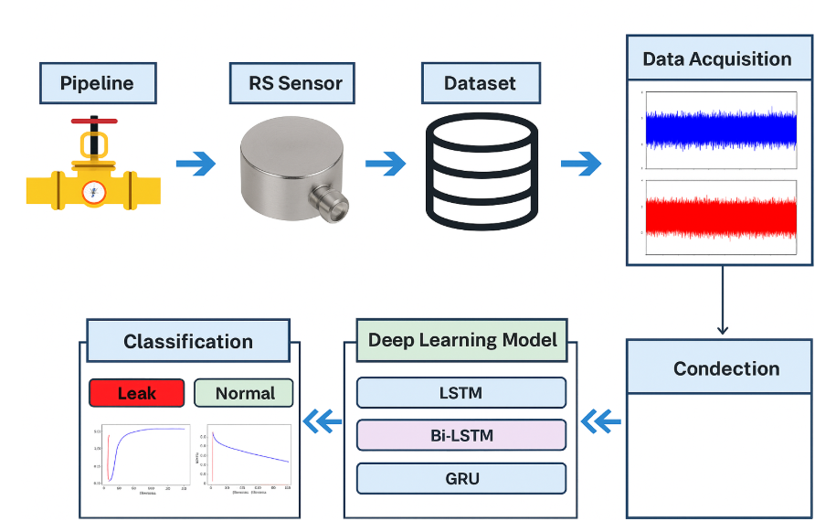
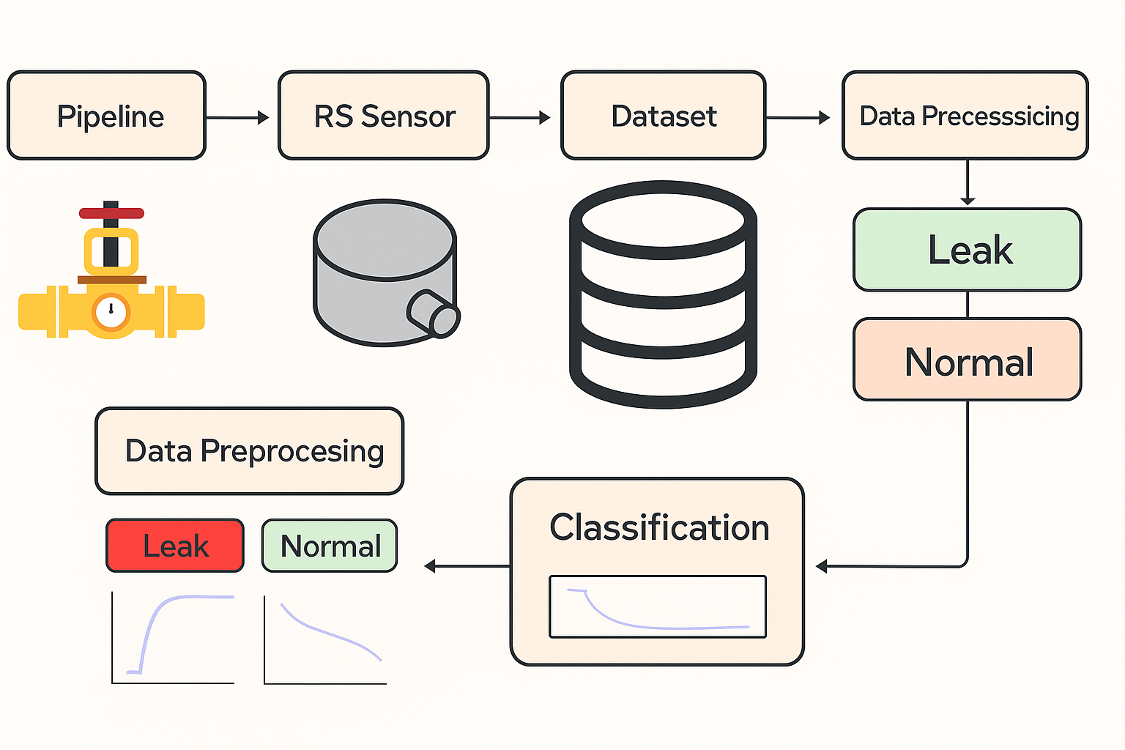

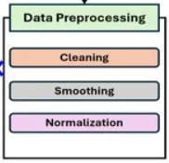
Product Architecture and Design/ Block Diagram

Slide 16
Algorithm
1. Data Collection
1.1 Install IoT sensors (flow, pressure, acoustic) at key points.
1.2 Continuously record time-series data.
1.3 Store readings in a central database/cloud.
2. Data Pre-processing
2.1 Remove noise using filters.
2.2 Handle missing values.
2.3 Normalise/standardise data.
2.4 Segment into fixed time intervals.
3. Feature Extraction
3.1 Calculate statistical measures (mean, SD, variance).
3.2 Detect sudden drops/spikes in readings.
3.3 Extract temporal and frequency-based features.

Slide 17
Algorithm
4. Model Training
4.1 Select ML model (e.g., LSTM, Random Forest).
4.2 Split data into training, validation, and testing sets.
4.3 Train and tune model parameters.
5. Real-Time Leak Detection
5.1 Acquire live sensor readings.
5.2 Apply same preprocessing and feature extraction steps.
5.3 Predict leak probability using trained model.
6. Alerts & Dashboard
6.1 Trigger alert if probability exceeds threshold.
6.2 Display leak location and severity on dashboard.
7. Continuous Learning
7.1 Validate predictions with field inspection.
7.2 Update dataset and retrain model periodically.

Slide 18
Module Description/ Component Specifications
RS Pro Pressure Sensor | Captures pipeline pressure; sudden drops indicate leaks
Wi-Fi | Provides connection to PC for real-time monitoring.
Module | Specification
C# with .NET Framework | Desktop app to receive data from ESP32, analyze, and visualize.
LiveCharts | Displays real-time RS Pro pressure sensor readings as graphs.
ML.NET | Runs anomaly detection models on pressure data for leak prediction.
CSV Logging | Stores data with timestamps for later review or ML training.

Slide 19
Justification for POSITIVE
Enhanced Safety: The system ensures continuous monitoring of pipeline conditions, detecting leaks early and reducing risks of water loss, contamination, or infrastructure damage.
Cost-Effective Solution: By using RS Pro pressure sensor, the system provides a low-cost yet reliable approach to water network safety.
Reliability in Harsh Environments: Designed for field deployment, the solution offers robust sensing and wireless communication even under varying environmental and operational conditions.
Alignment with SDGs: Supports the United Nations Sustainable Development Goals, particularly Goal 6 (Clean Water and Sanitation) by reducing water losses, and Goal 11 (Sustainable Cities and Communities) through improved infrastructure resilience.
Resource Conservation: Early detection of leaks minimizes water wastage, contributing to sustainable management of scarce water resources.
Technological Integration: Combines real-time pressure sensing, data visualization, and optional machine learning analysis for accurate and efficient leak detection.

Slide 20
Project Showcase and Future Steps
Project Showcase
System FeaturesReal-time pressure monitoring, leak detection alerts, and data visualization for water supply networks.
Demonstration: Live prototype showing RS Pro sensor readings, detection of simulated leaks, and dashboard visualization.
Technological Highlights: wireless real-time data transfer, C# dashboard with LiveCharts
Use Cases: Municipal water supply monitoring, industrial pipeline safety, and smart city water management.
Future Steps
Enhancements:Integrate flow/acoustic sensors and automated valve control for faster leak isolation.
Scalability: Extend the system for large-scale water distribution networks with multiple nodes.
Collaboration: Partner with water utilities and smart city projects to pilot and refine the solution.

Slide 21
Project Budget
Hardware Development
Pressure / Flow Sensors: $80 per unit × 30 units = $2,400
Software Development
C# Desktop Application= $4,000
LiveCharts Integration=$1,000
ML.NET Model Development = $3,500
Testing and Debugging= $2,500
Personnel Costs
Engineers & Developers: 3 specialists for 3 months = $18,000
Testing Team: 2 testers for 2 months = $4,000
Production and Marketing
Manufacturing Setup: Small-scale production and QC = $2,000
Marketing & Branding: Targeted campaigns = $3,000
Shipping & Logistics: Delivery of components and prototypes = $1,500
Miscellaneous
Contingency Fund: Minor unforeseen adjustments = $3,500 Total Project Budget: $43,900

Slide 22
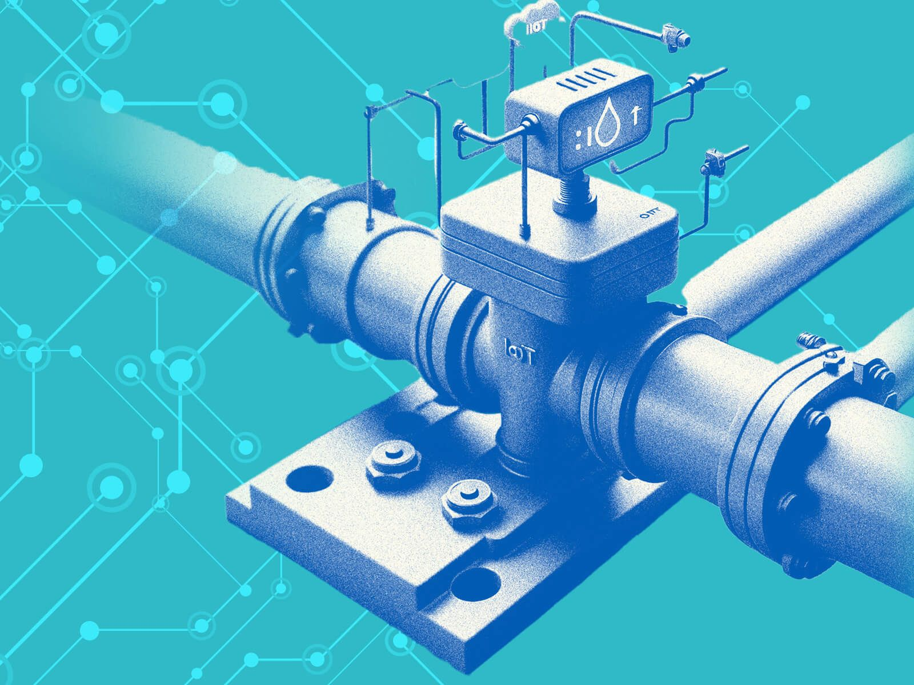
Conclusion
The proposed pipeline leak detection system employs technologies such as the RS Pro pressure sensor for real-time monitoring.
It ensures water network safety by detecting leaks early and minimizing losses.
The system provides live data visualization and alerts through a C# dashboard for faster decision-making.
It is designed to be reliable in varied environmental conditions, ensuring consistent performance.
Scalability and integration of machine learning enable predictive analysis and improved efficiency in water management.

Slide 23
Reference
1.N. Ullah, Z. Ahmed and J.-M. Kim, "Pipeline Leakage Detection Using Acoustic Emission and Machine Learning Algorithms," Sensors, vol. 23, no. 6, p. 3226, Mar. 2023, doi: 10.3390/s23063226.
2. R. Uddin, T. Hoang, J. H. Kim and D. Kim, "Machine Learning Model for Leak Detection Using Water Pipeline Vibration Sensor," Sensors, vol. 23, no. 21, p. 8935, Nov. 2023, doi: 10.3390/s23218935.
3. F. Saleem, Z. Ahmad and J.-M. Kim, "Real-Time Pipeline Leak Detection: A Hybrid Deep Learning Approach Using Acoustic Emission Signals," Applied Sciences, vol. 15, no. 1, p. 185, Jan. 2025, doi: 10.3390/app15010185.
4. M. Almasri, K. Elsayed, A. Awad and H. Zayed, "A Smart Water Pipeline Monitoring System Using IoT and Machine Learning," Sustainable Cities and Society, vol. 92, p. 104506, Feb. 2023.
5. "Enhancing Pipeline Leakage Detection Through Multi-Algorithm Fusion With Machine Learning," Processes, vol. 13, no. 5, p. 1519, May 2025, doi: 10.3390/pr13051519.

Slide 24
Thank You

